Slide 1







Electrolysis and Electrical Properties of Solution

Slide 2
PRESENTED TO
MD. SHAKIL AHMED
Lecturer
Dept. of Textile Engineering
Green University

Slide 3
The Author’s
Shahinur Rahman - 203002070
Joy Pal - 201002418
Fahim Tazwoar Sourav - 201002110
Nusrat Jahan Nizhum - 203002037
Sabina Yasmin Kalpona - 203002023

Slide 4
Contents
Electrolysis
Electrical Units
FARADAY’s Laws of Electrolysis
Conductance of Electrolytes
Electrolytic conductance
Strong Electrolytes
Weak Electrolytes

Slide 5
Electrolysis
A process where electrical energy is transformed into chemical energy
It is not spontaneous, electrical energy must be supplied for a reaction to occur

Slide 6
Application of Electrolysis
Electroplating
Extraction of reactive metals such as Na, Al from metal ore
Industrial production of NaOH, Cl2,H2
Recharging of car batteries & other rechargeable cells
Refining of copper metals

Slide 7
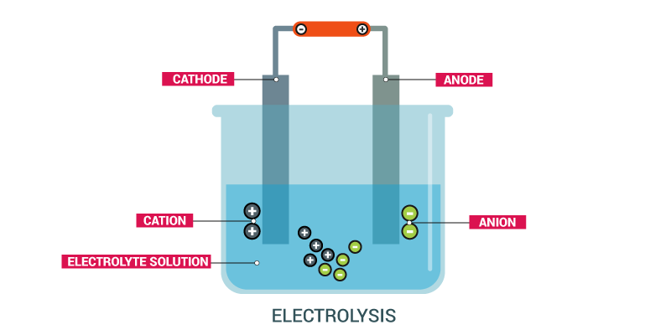
Mechanism of Electrolysis

Slide 8
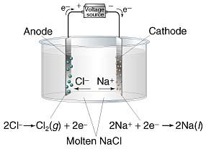
Electrolytic Conductance of NaCl
An electrolytic cell consists of two electrodes
A DC battery
NaCl (molten)

Slide 9
Electrical Units
Coulomb ( C ) - is a unit quantity of electricity.
Ampere ( A ) - is a unit rate of flow of electricity.
Ohm ( Ω ) - is a unit of electrical resistance.
Volt ( V ) - is a unit of electromotive force.

Slide 10
FARADAY’s Laws of Electrolysis
First Law:
The amount of a given product liberated at an electrode during electrolysis is directly proportional to the quantity of electricity which passes through the electrolyte solution.
m = ZQ
Unit is grams per coulomb ( g/C )

Slide 11
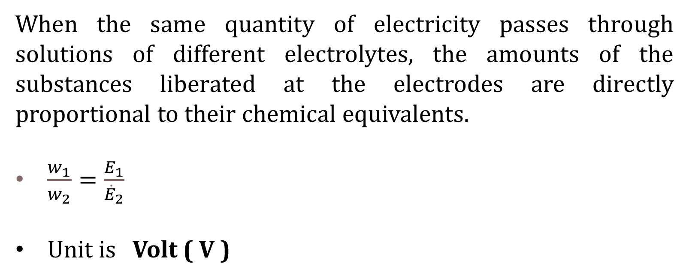
FARADAY’s Laws of Electrolysis
Second Law:
When the same quantity of electricity passes through solutions of different electrolytes, the amounts of the substances liberated at the electrodes are directly proportional to their chemical equivalents.
$\frac{w_{1}}{w_{2}}=\frac{E_{1}}{{\dot{E}}_{2}}$
Unit is Volt ( V )

Slide 12
Conductance of Electrolytes
The power of electrolytes to conduct electric currents is termed conductivity or conductance.
The flow of electricity through an electrolytic conductor.
Electricity passes in the form of ions.
Three main factors :
1. The concentration of ions
2. The types of ions
3. Temperature

Slide 13
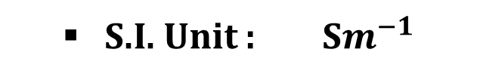
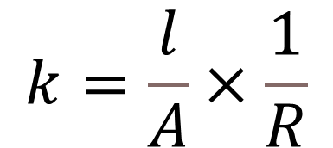
Specific Conductance
The ability of a substance to conduct electricity.
It is Denoted by K (Kappa).
It is the reciprocal of resistivity ( ρ ).
$$k=\frac{l}{A}×\frac{1}{R}$$
S.I. Unit : S$m^{−1}$

Slide 14

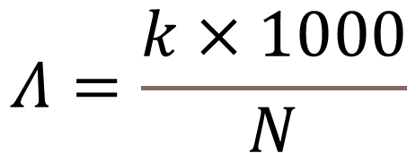
Equivalent Conductance
The volume of solution containing one equivalent of an electrolyte.
It is denoted by the symbol Λ ( Lamda).
It is helpful to get comparable results for different electrolytes.
$$Λ=\frac{k×1000}{N}$$
Unit : Siemens $m^{2}$/equivalent

Slide 15
Types of Electrolytes
Electrolytes
Strong Electrolytes
Weak Electrolytes
Non Electrolytes

Slide 16
Strong Electrolytes
A substance that gives a solution in which almost all the molecules are ionized.
Strong acidic electrolytes : HCl, H2SO4, HNO3
Strong bases electrolytes : NaOH, KOH, Ca (OH)2
Salts electrolytes : Most of the salts are electrolytes

Slide 17
Weak Electrolytes
A substance that gives a solution in which only a small proportion of the solute molecules are ionized
Weak acidic electrolytes : All organic are examples of weak electrolytes.
Weak bases electrolytes : Most organic bases e.g., alkyl amines (C2H5NH2) are weak electrolytes
Salts : A few salts such as mercury (II) chloride and lead (II) acetate are weak electrolytes

Slide 18
Non-Electrolytes
Typically polar covalent substances that do dissolve in water as molecules instead of ions.
They do not conduct electricity at all.
Glucose ( C₆H₁₂O₆ )

Slide 19


